Slide 1
Distributed Systems
Ali Kamandi, PH.D.
School of Engineering Science
College of Engineering
University of Tehran
kamandi@ut.ac.ir

Slide 2

توصیف رسمی
نمایش ریاضی سیستم
جبر +, - , *, /
منطق
مجموعه ها

Slide 3
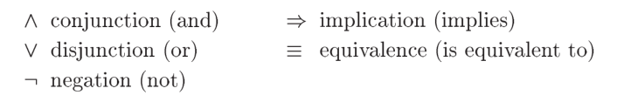
Propositional Logic

Slide 4

Predicate Logic
Predicate logic extends propositional logic with the two quantifiers:

Slide 5
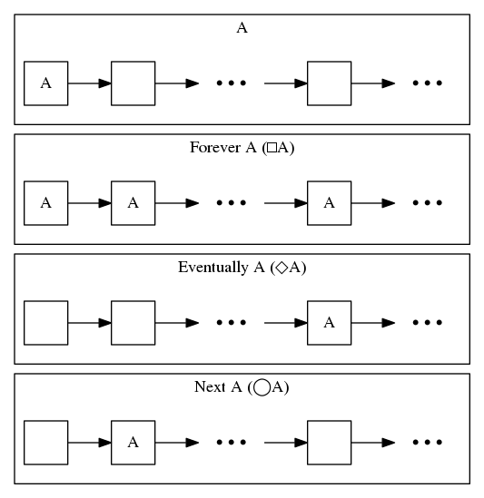
Temporal Logic

Slide 6
Specifying a simple clock
An hour clock (HC)
A typical behavior of the clock is the sequence of states:
[hr = 11] is a state in which the variable hr has the value 11
A pair of successive states, such as [hr = 1] → [hr = 2], is called a step.

Slide 7

To specify the hour clock, we describe all its possible behaviors.
We write an initial predicate that species the possible initial values of hr , and a next-state relation that species how the value of hr can change in any step.
… is informal.

Slide 8
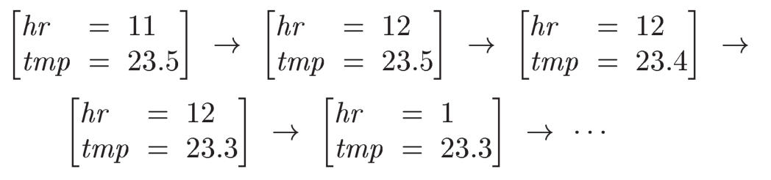


Weather station:

Slide 9
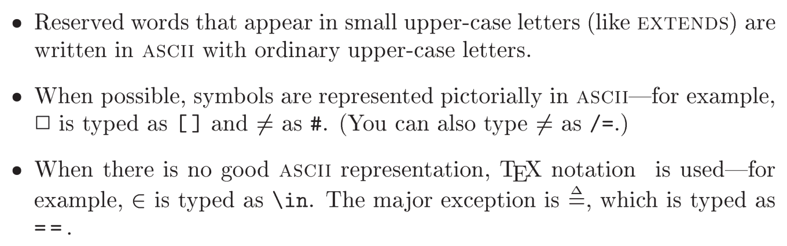
TLA+

Slide 10
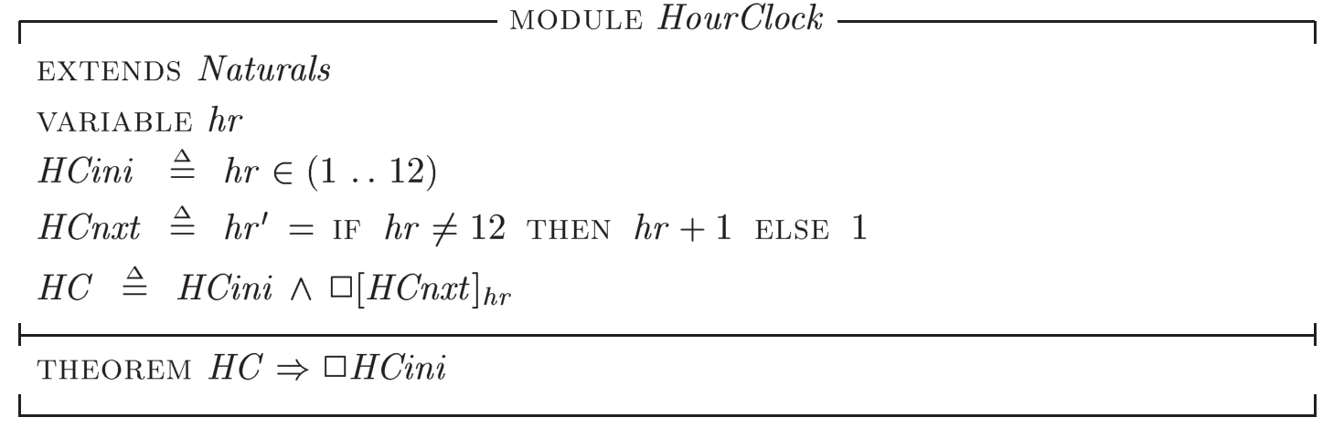

Slide 11
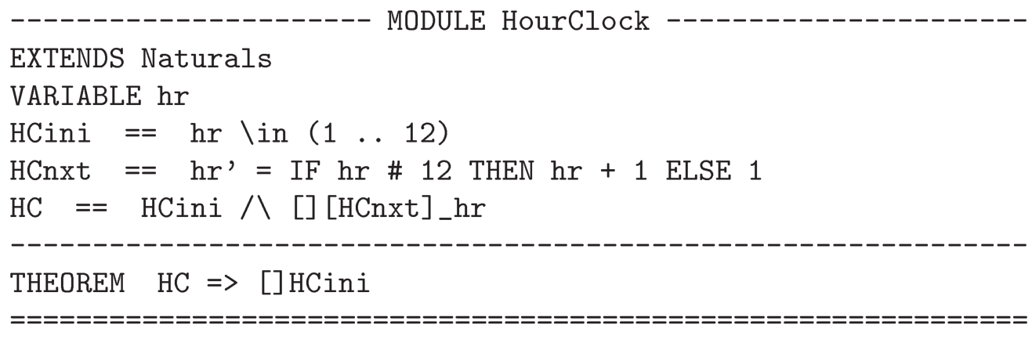

Slide 12
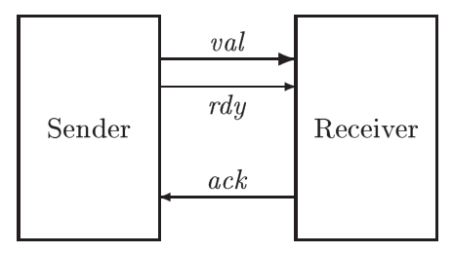
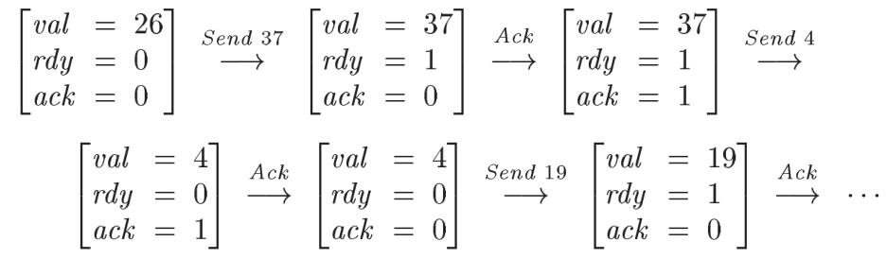
An Asynchronous Interface

Slide 13
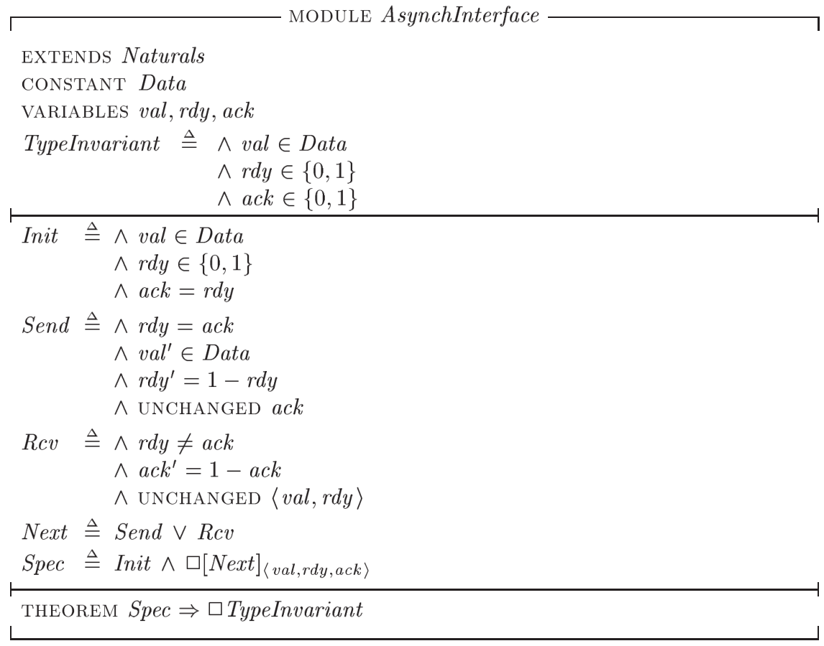

Slide 14
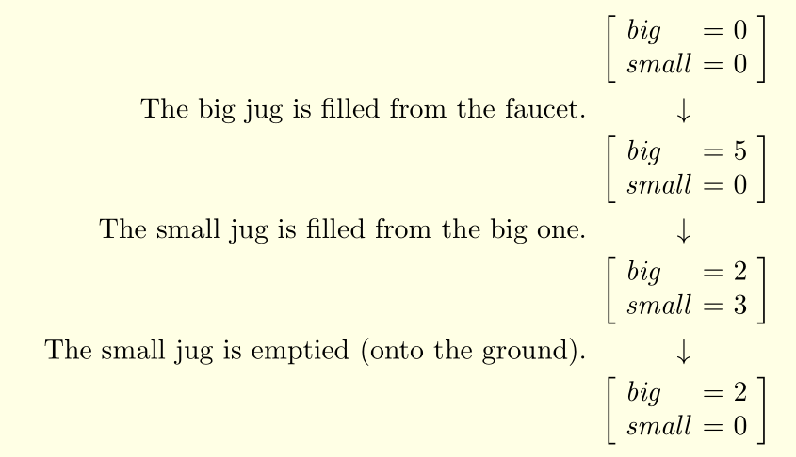

Slide 15
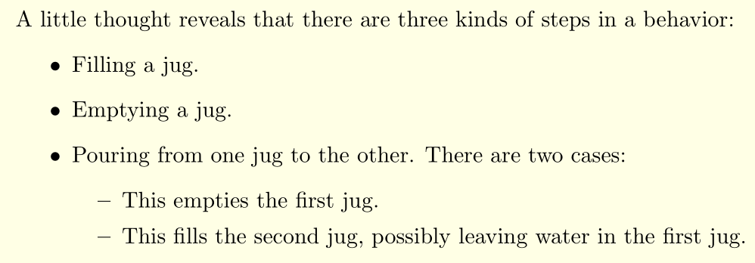

Slide 16



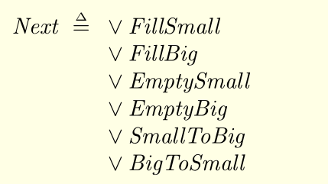

Slide 17

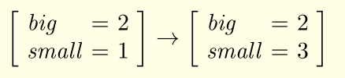



Slide 18



FillBig

Slide 19
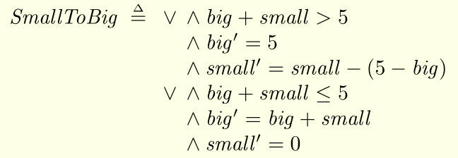
SmallToBig

Slide 20

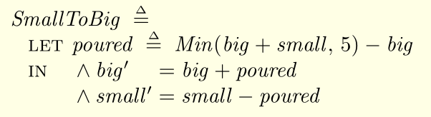

Slide 21
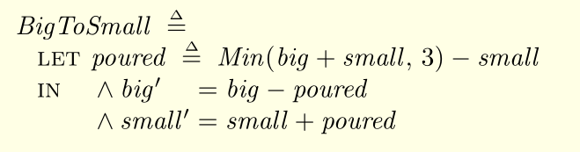
BigToSmall

Slide 22
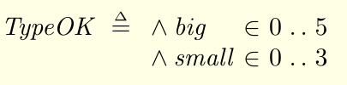
Invariant:

Slide 23
منابع
Leslie Lamport, Specifying Systems, The TLA+ Language and Tools for Hardware and Software Engineers, Addison-Wesley, 2002.

